Slide 1
Blood Donation Management System
Group Members :
1) Basit Sameer 23WBCS0975
2) Muhammad Ibrahim 23PWBCS0960
3) Hamza Khan 23PWBCS0979
4) Muhammad Abbas 23PWBCS1011

Slide 2
Introduction
What is this system about? This is a web-based Blood Donation Management System that handles donor registration, blood requests, and availability.
Why is it useful? It makes blood donation easier, faster, and more organized for both donors and hospitals.

Slide 3
Objectives
Maintain accurate donor records
Efficiently manage and respond to blood requests
Ensure timely availability of required blood types
Provide a simple and user-friendly interface for both admin and users

Slide 4
Tools and Technologies
Frontend: HTML, CSS, JavaScript
Backend: Node.js (or Express if used)
Database: MySQL
Server: Localhost

Slide 5
System Architecture
User
Browser
Frontend
HTML, CSS, JS
Backend
Node.js
Database
MySQL

Slide 6
Database Design
Table Name | Description
Donors | Stores donor information like name, blood type, contact details, and donation history.
Requests | Records blood requests including requester info, blood type needed, and request status.
Blood Types | Contains blood group details (A+, B-, O+, etc.) and related info.
Users | Manages system users (admins and regular users) with login credentials and roles.
1. Overview
The database is designed to store all important information about donors, blood requests, blood types, and users.
It ensures data is organized for easy retrieval and management.

Slide 7
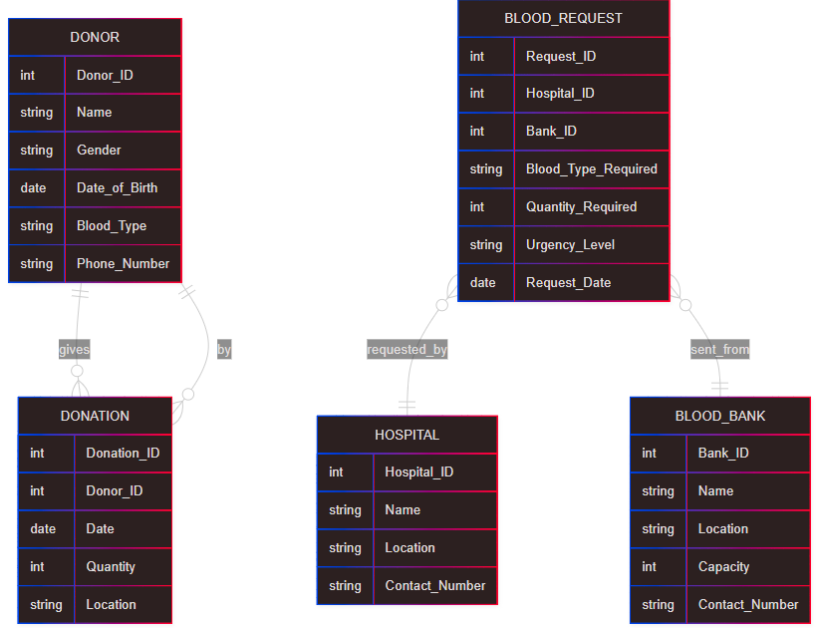
ER Diagram

Slide 8
Key Features
Our Blood Donation Management System offers the following core features:
Donor Registration: Users can register as blood donors by submitting personal and blood-related information.
Blood Request Form: Patients or hospitals can request specific blood types using an easy-to-fill online form.
Admin Approval System: Admins verify donor and request entries to ensure authenticity and manage the system securely.
Search by Blood Group: Users can search and filter available donors based on blood group, location, and availability.

Slide 9
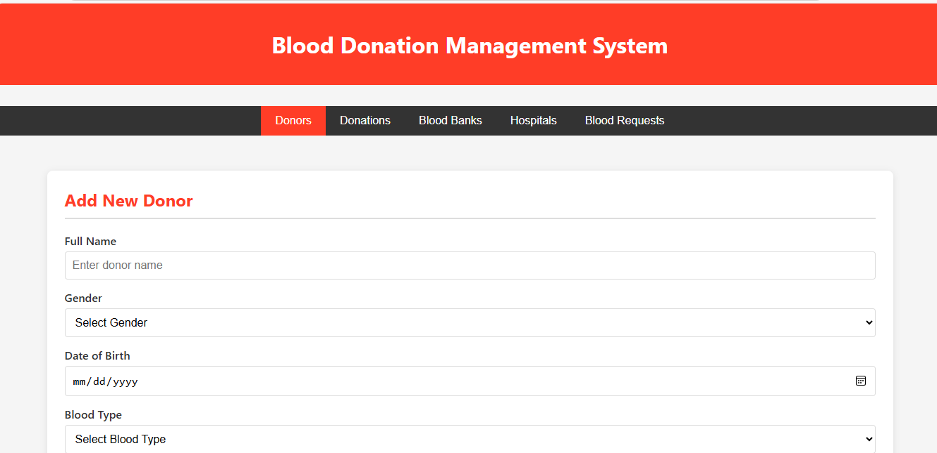
Home Page

Slide 10
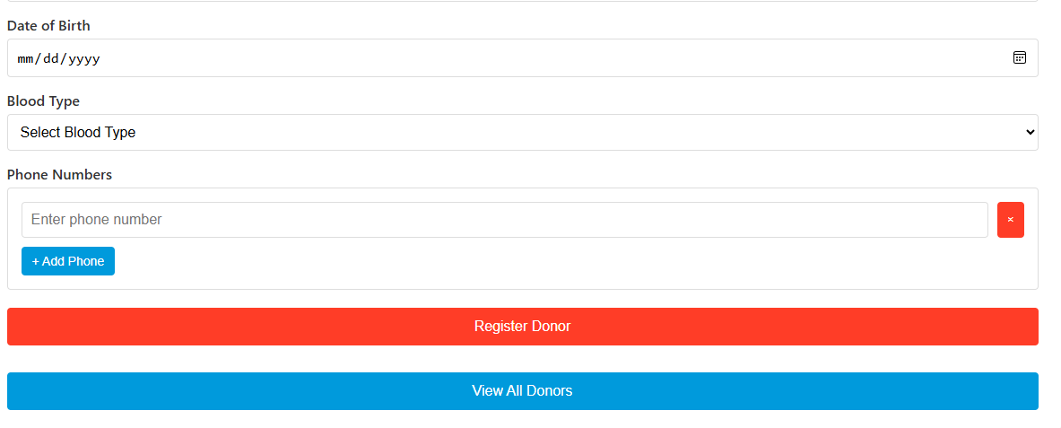
Home Page

Slide 11
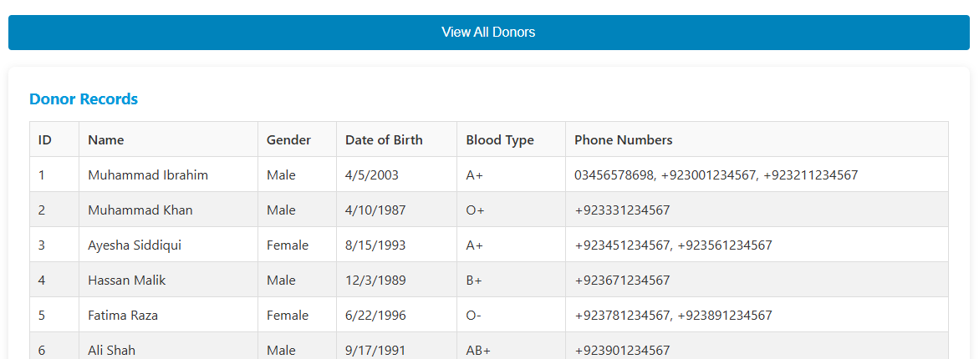
Home Page

Slide 12
Challenges Faced
Styling Forms & Tables: Making the interface clean and responsive using CSS.
Frontend-MySQL Connection: Linking JavaScript to MySQL through Node.js setup.
Data Validation: Ensuring all user inputs are correct and complete.

Slide 13
Conclusion
We built a web-based Blood Donation Management System that handles donor records, blood requests, and admin approvals.
Future Improvements:
Add secure login/signup system
Enable email notifications for donors and requests
Deploy the system on an online server for real-time access

Slide 14
Q & A
Thank you for your attention. We’re happy to answer any questions you may have.
Any Questions?

